Slide 1
Deep Portfolio Theory
Presented by: Jinyang Li; Linda Wu; Lina Wang
ACTSC 972 Midterm Project

Slide 2
INTRODUCTION
OVERVIEW
Deep portfolio theory builds on Markowitz’s classic risk-return trade-off and makes use of the deep learning techniques to construct portfolios.
It first encodes the market information and then decodes it to form a portfolio that is designed to achieve the goal.
It relies on deep factors which have a non-linear relationship to the input data.
Primary strength: avoid any statistical inputs such as expected returns or variance-covariance matrices.
Objective: formulate an automated and general portfolio selection process (4 steps): Auto-Encoding; Calibration; Validation; Verification.

Slide 3
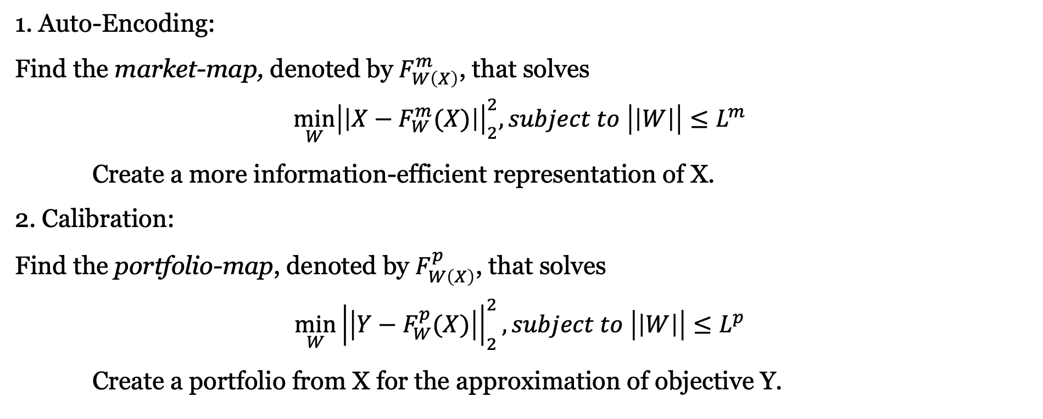
INTRODUCTION
4 STEPS
1. Auto-Encoding:
Find the market-map, denoted by $F_{W\left(X\right)}^{m}$, that solves
$$\min_{W}{{\left|\left|X−F_{W}^{m}(X)\right|\right|}_{2}^{2}, subject to \left|\left|W\right|\right|≤L^{m}}$$
Create a more information-efficient representation of X.
2. Calibration:
Find the portfolio-map, denoted by $F_{W\left(X\right)}^{p}$, that solves
$$\min_{W}{{\left|\left|Y−F_{W}^{p}(X)\right|\right|}_{2}^{2}, subject to \left|\left|W\right|\right|≤L^{p}}$$
Create a portfolio from X for the approximation of objective Y.

Slide 4
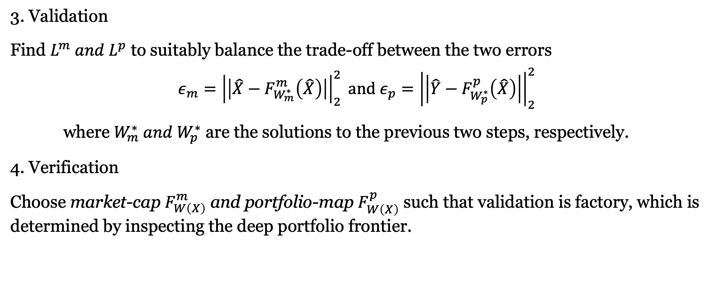
INTRODUCTION
4 STEPS
3. Validation
Find $L^{m} and L^{p}$ to suitably balance the trade-off between the two errors
$$ε_{m}={\left|\left|\hat{X}−F_{W_{m}^{∗}}^{m}\left(\hat{X}\right)\right|\right|}_{2}^{2} and ε_{p}={\left|\left|\hat{Y}−F_{W_{p}^{∗}}^{p}\left(\hat{X}\right)\right|\right|}_{2}^{2}$$
where $W_{m}^{∗} and W_{p}^{∗}$ are the solutions to the previous two steps, respectively.
4. Verification
Choose market-cap $F_{W\left(X\right)}^{m}$ and portfolio-map $F_{W\left(X\right)}^{p}$ such that validation is factory, which is determined by inspecting the deep portfolio frontier.

Slide 5
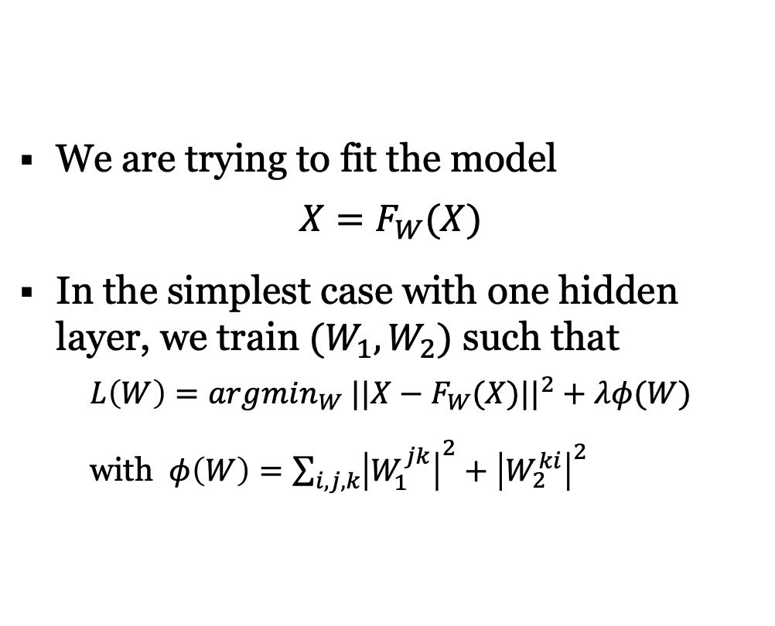
Introduction – Auto encoder
ARCHITECTURE
We are trying to fit the model
$$X=F_{W}(X)$$
In the simplest case with one hidden layer, we train $(W_{1},W_{2})$ such that
$$L\left(W\right)=argmin_{W} ||X−F_{W}(X)||^{2}+λφ(W)$$
with $φ\left(W\right)=\sum_{i,j,k}{{\left|W_{1}^{jk}\right|}^{2}+{\left|W_{2}^{ki}\right|}^{2}}$

Slide 6
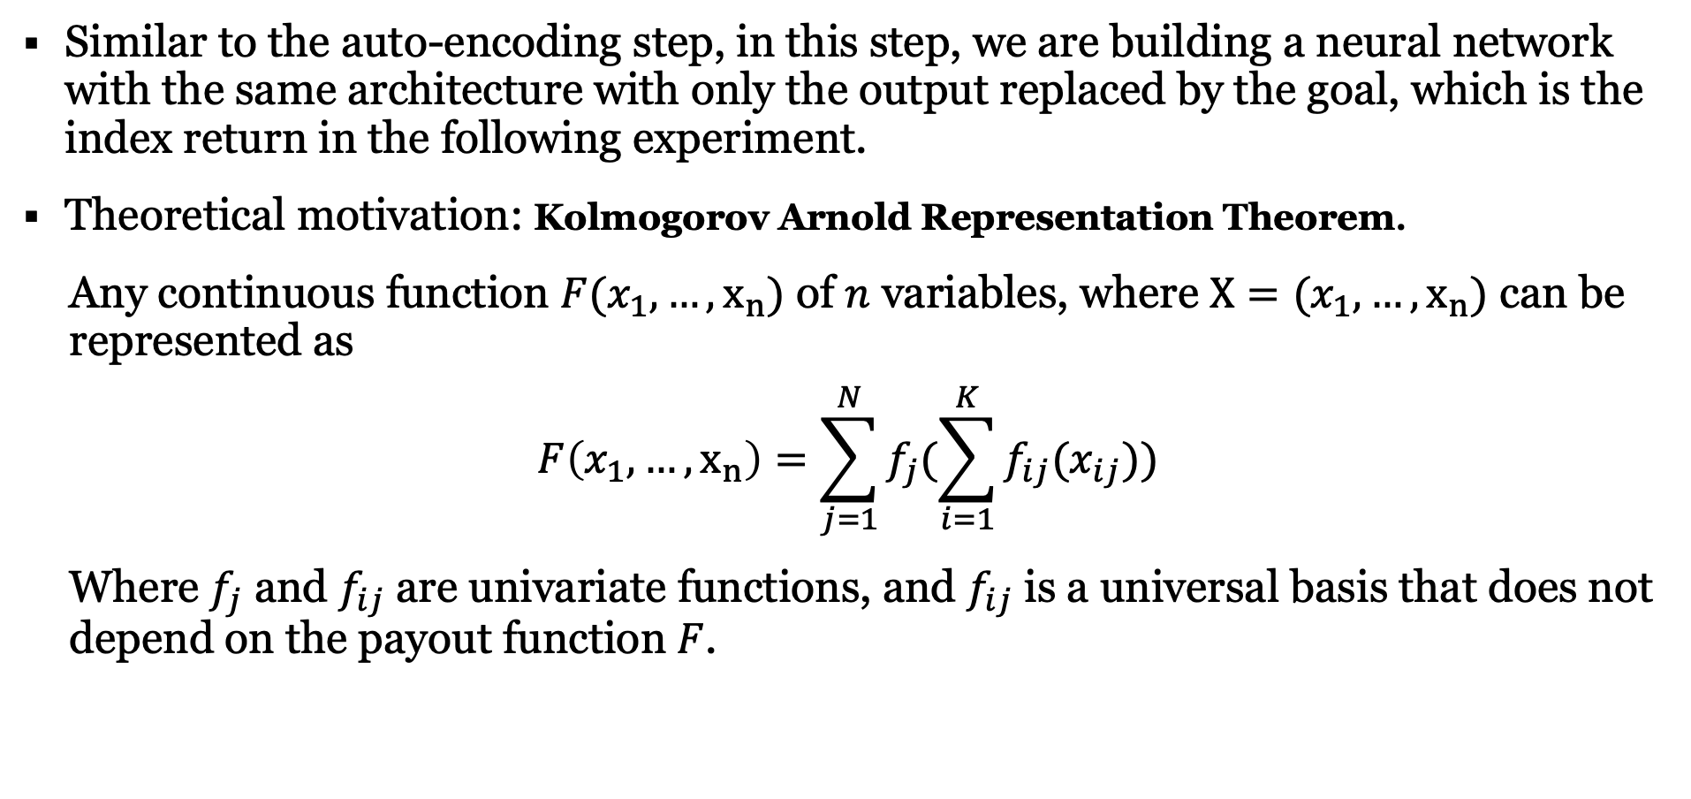
Introduction – traditional factor models
ARCHITECTURE
Similar to the auto-encoding step, in this step, we are building a neural network with the same architecture with only the output replaced by the goal, which is the index return in the following experiment.
Theoretical motivation: Kolmogorov Arnold Representation Theorem.
Any continuous function $F(x_{1},…,x_{n})$ of $n$ variables, where $X=(x_{1},…,x_{n})$ can be represented as
$$F\left(x_{1},…,x_{n}\right)=\sum_{j=1}^{N}{f_{j}(\sum_{i=1}^{K}{f_{ij}(x_{ij})})}$$
Where $f_{j}$ and $f_{ij}$ are univariate functions, and $f_{ij}$ is a universal basis that does not depend on the payout function $F$.

Slide 7
NUMERICAL EXPERIMENT
The paper has retraced the IBB Index as an numerical example.
The goal is to find a small selection of stocks for which a deep portfolio structure with good out-of-sample tracking properties can found.
IBB tracks an index composed of biotechnology and pharmaceutical equities listed on the NASDAQ.
Number of holdings as of 10/29/2019: 218 stocks (89 after data cleaning).
We have successfully replicated the four steps in the paper with satisfied result achieved.
In our project, we are retracing another index, IVW, by applying the deep portfolio theory.

Slide 8
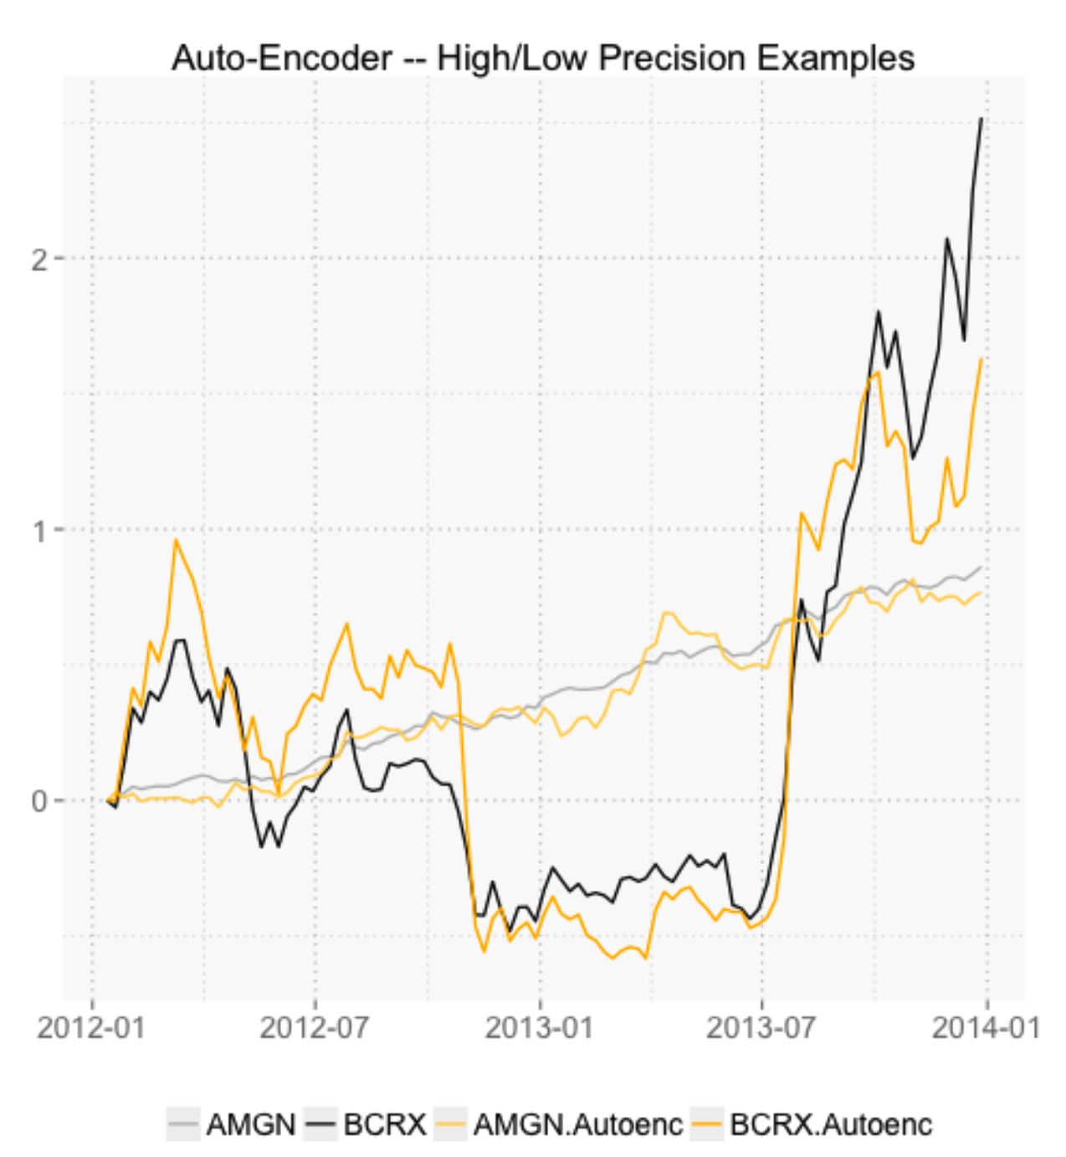
Auto-Encoding - IBB Index
Step 1
Original Paper Result
Our replication on IVW Index

Slide 9
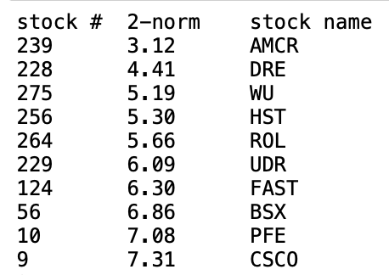
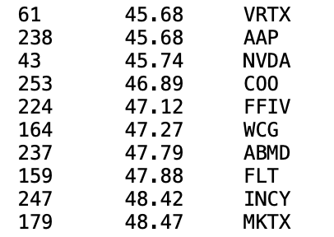
Auto-Encoding - IBB Index
Step 1
Communal Information: 2-norm difference between every stock and its auto-encoded version.
Construct our deep portfolio by using the top x and bottom y stocks ranking by communal information.
TOP
Bottom

Slide 10
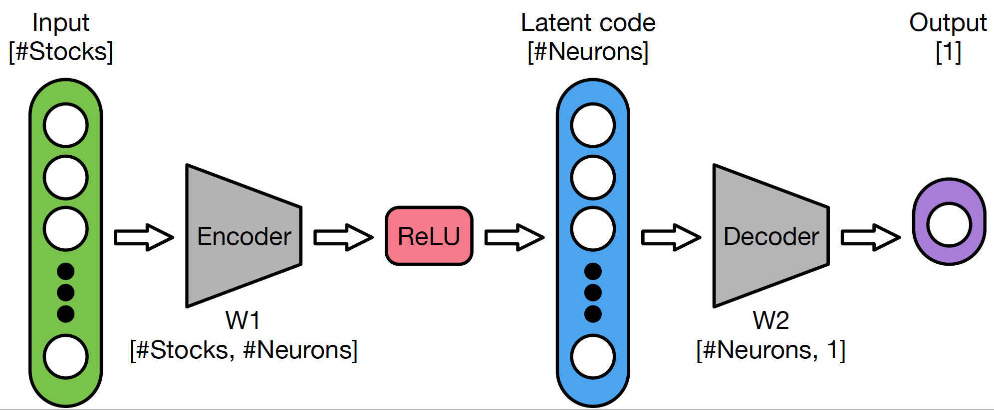
Calibration - IBB Index
Step 2

Slide 11
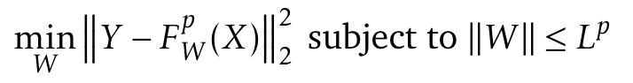
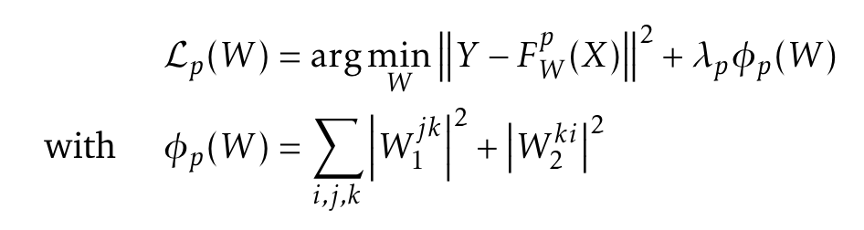

Calibration - IBB Index
Step 2
Goal: For a desired result (or target) Y , find the portfolio-map, denoted by $F_{W}^{p}(X)$, that solves the regularization problem:
In our implementation

Slide 12
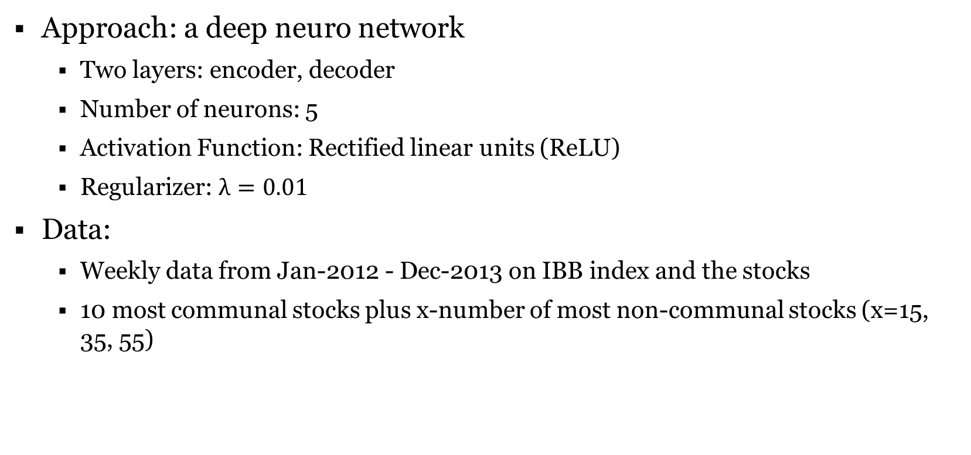
Calibration - IBB Index
Step 2
Approach: a deep neuro network
Two layers: encoder, decoder
Number of neurons: 5
Activation Function: Rectified linear units (ReLU)
Regularizer: $λ=0.01$
Data:
Weekly data from Jan-2012 - Dec-2013 on IBB index and the stocks
10 most communal stocks plus x-number of most non-communal stocks (x=15, 35, 55)

Slide 13
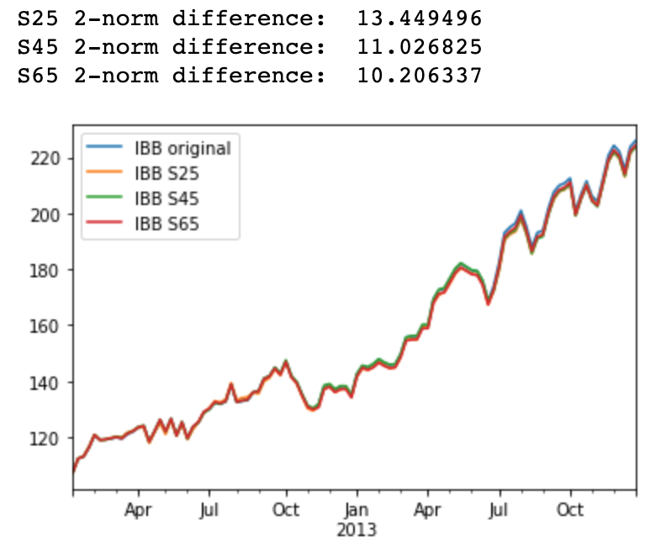
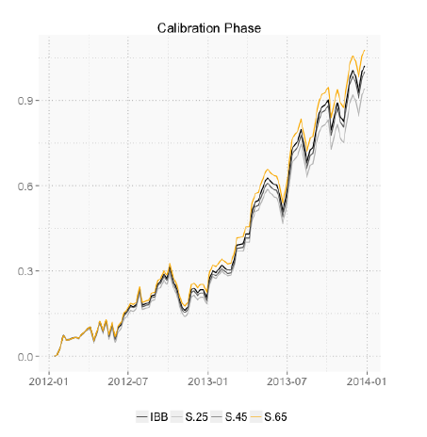
Calibration - IBB Index
Step 2

Slide 14
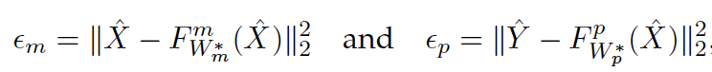
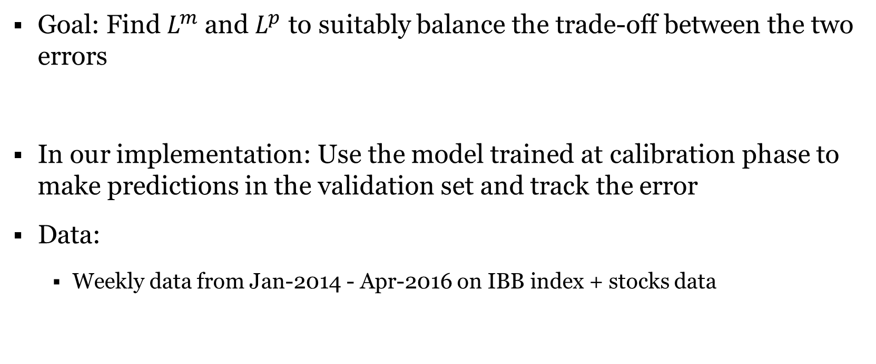
Validation - IBB Index
Step 3
Goal: Find $L^{m}$ and $L^{p}$ to suitably balance the trade-off between the two errors
In our implementation: Use the model trained at calibration phase to make predictions in the validation set and track the error
Data:
Weekly data from Jan-2014 - Apr-2016 on IBB index + stocks data

Slide 15
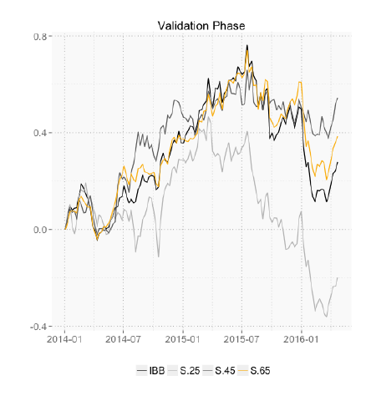
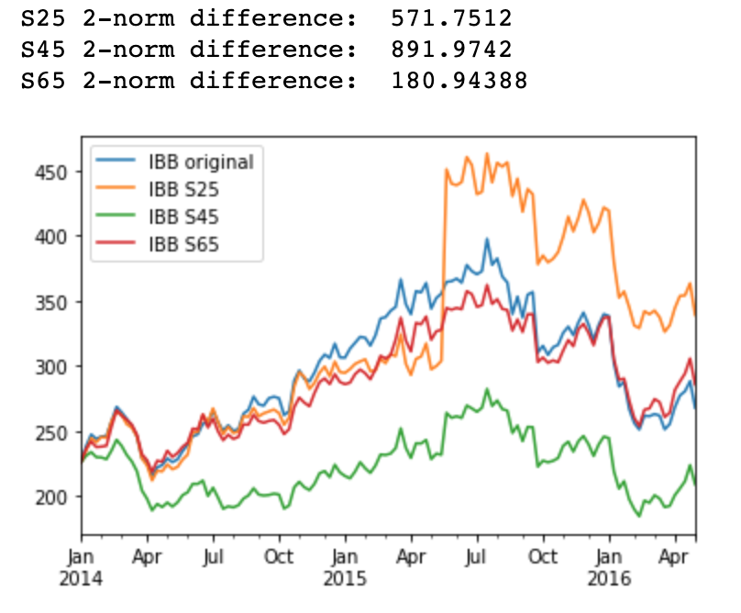
Validation - IBB Index
Step 3

Slide 16
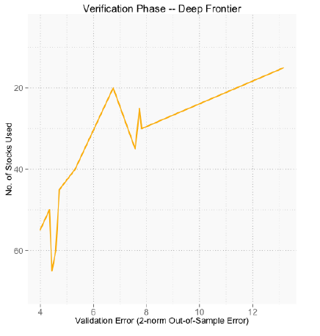
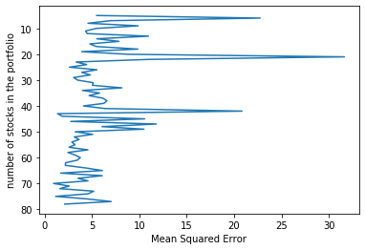
verification - IBB Index
Step 4
Verifying the chosen number of stocks using out-of-sample data
Estimating the accuracy of selected approach using different number of stocks

Slide 17
Alternative dataset
In our project, we retraced another index, IVW, by the deep portfolio theory following the same four-step routine.
IVW tracks an index of large-cap US stocks. The index selects stocks with growth characteristics from the S&P 500 Index.
Number of holdings as of 10/29/2019: 297 stocks (289 after data cleaning)

Slide 18
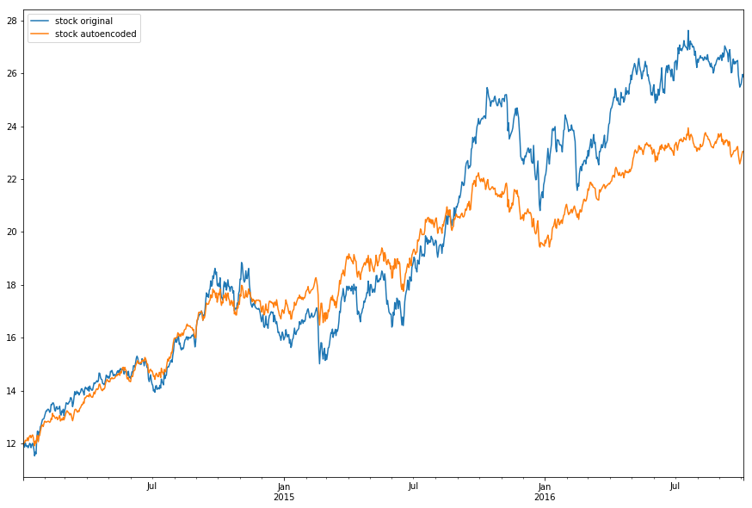
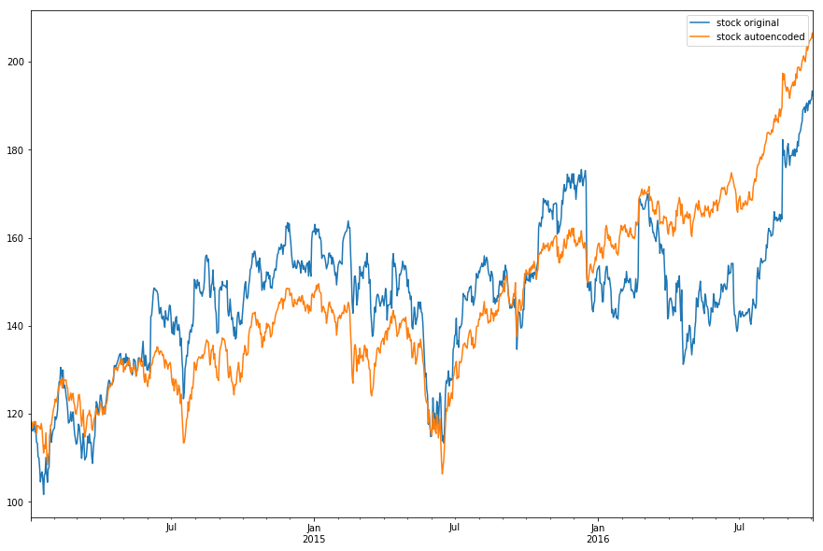
Auto-Encoding - IVW Index
Step 1

Slide 19
Calibration - IVW Index
Step 2
Calibration Phase:
Include 15 most communal stocks (communal degree: 3.12 to 7.61)
Increase the number of neurons from 5 to 16
Extend the training data set: daily data from Jan-2014 to Dec-2017
Change the number of tracking stocks accordingly

Slide 20
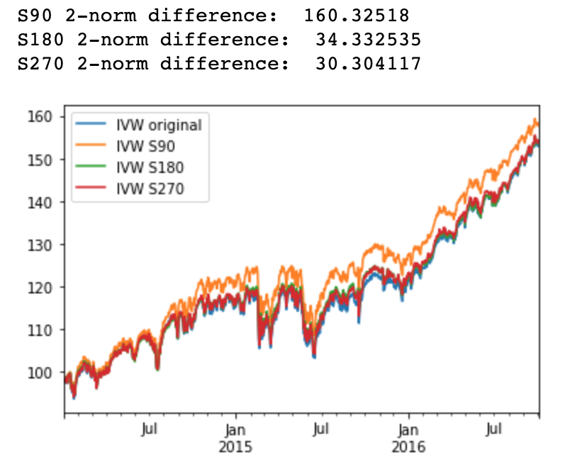
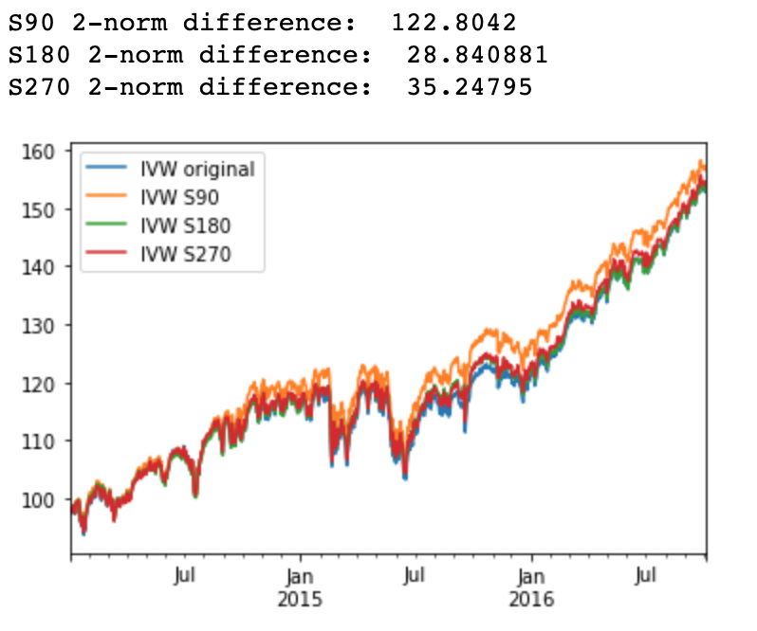
Calibration - IVW Index
Step 2
# of neurons = 16
# of neurons = 64

Slide 21
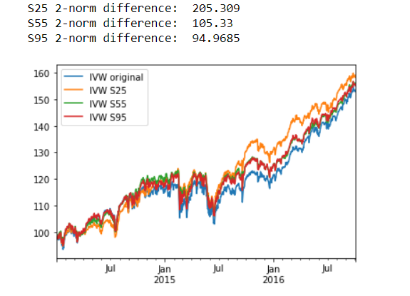
calibration - IVW Index
Step 2
More stocks
Fewer stocks

Slide 22
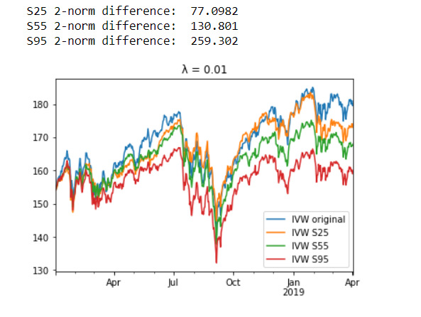
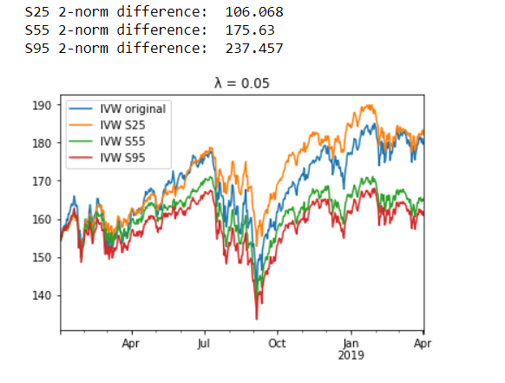
validation - IVW Index
Step 3
λ = 0.01
λ = 0.05

Slide 23
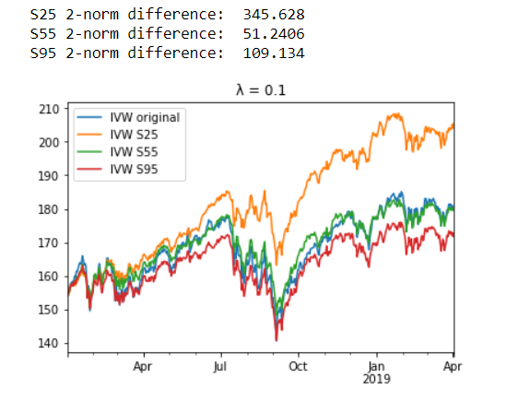
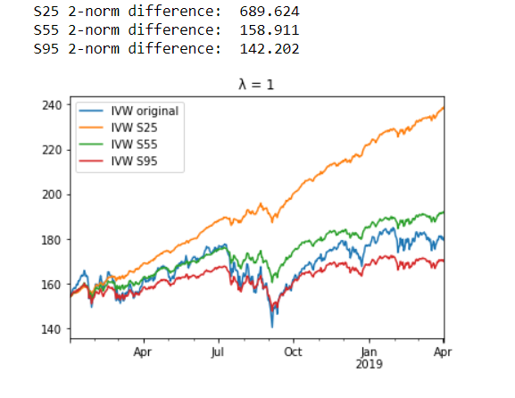
validation - IVW Index
Step 3
λ = 0.1
λ = 1

Slide 24
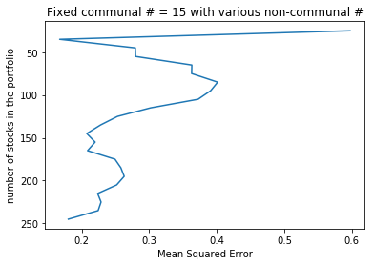
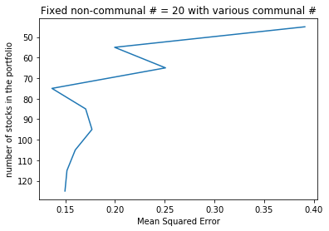
Verification - IVW Index
Step 4
Verifying the number of stocks chosen to track the index
Estimating the accuracy of selected approach using different number of stocks
Fixed communal stocks
Fixed non-communal stocks

Slide 25
Summary
The authors developed a four-step routine of auto-encode, calibrate, validate and verify for portfolio selection.
The large data set of historical returns were encoded and reduced to an information subset, and then decoded to achieve a pre-specified goal.
An appropriate amount of regularization was chosen to optimize the out-of-sample performance.
We implemented the method in the IBB index from the original paper and an additional index, IVW, for testing.
(Not shown in slides) In order to beat the index return, the authors amended the target index data during the calibration phase.

Slide 26
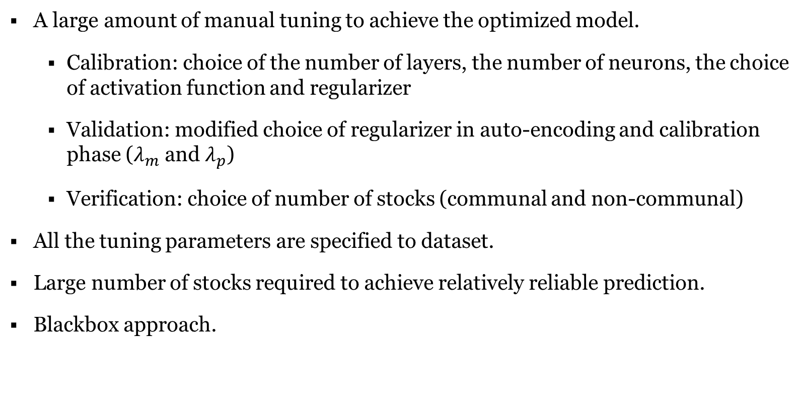
Critical Assessment/Limitations
A large amount of manual tuning to achieve the optimized model.
Calibration: choice of the number of layers, the number of neurons, the choice of activation function and regularizer
Validation: modified choice of regularizer in auto-encoding and calibration phase ($λ_{m}$ and $λ_{p}$)
Verification: choice of number of stocks (communal and non-communal)
All the tuning parameters are specified to dataset.
Large number of stocks required to achieve relatively reliable prediction.
Blackbox approach.

Slide 27
Reference
Heaton J., N.G. Polson and J.H. Witte, Deep learning for finance: deep portfolios, Appl. Stochastic Models Bus. Ind., 2017, 33, 3–12.
Heaton J., N.G. Polson and J.H. Witte, Deep Portfolio Theory, arXiv:1605.07230v1, revised 23 May 2016.
Hinton G.E., R.R. Salakhutdinov, Reducing the dimensionality of data with neural networks. Science, 2006, 313(5786), 504–507.
Cook R.D., Fisher lecture: dimension reduction in regression. Statistical Science 2007, 1–26.

Slide 28
Thanks for listening

